Slide 1
Best in Show:

Slide 2
Best in Show: cOSTUME

Slide 3
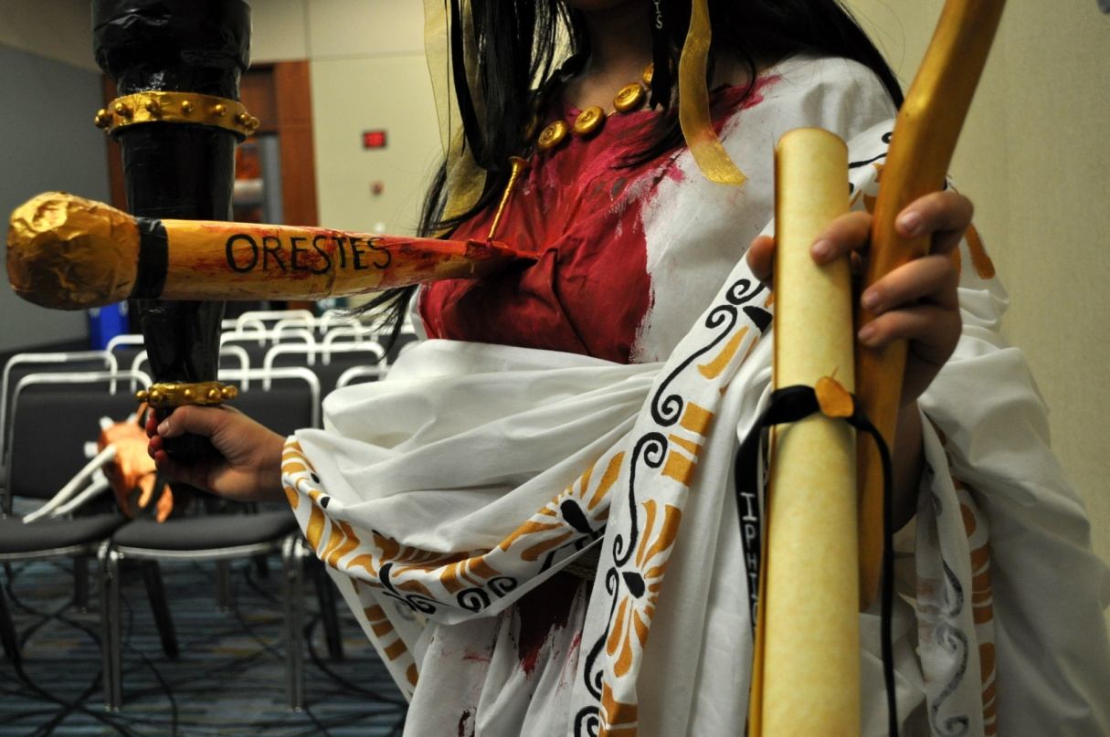
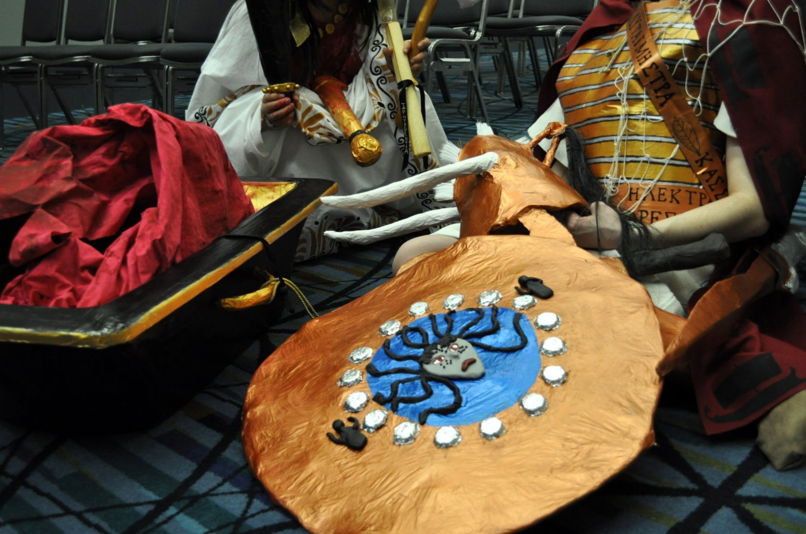

Slide 4
Best in Show: aRT

Slide 5
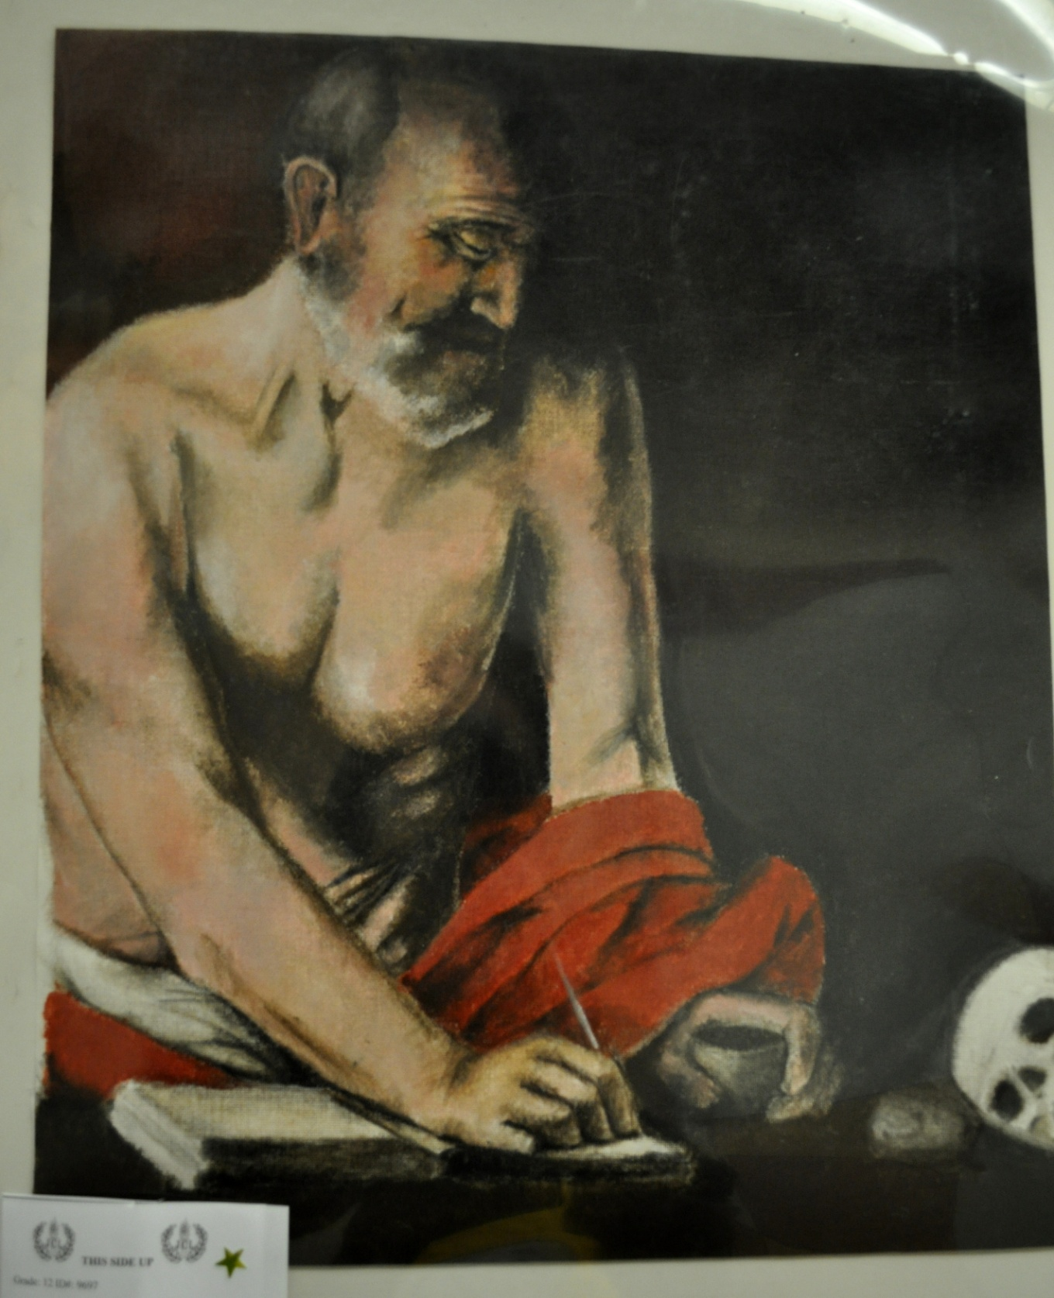

Slide 6
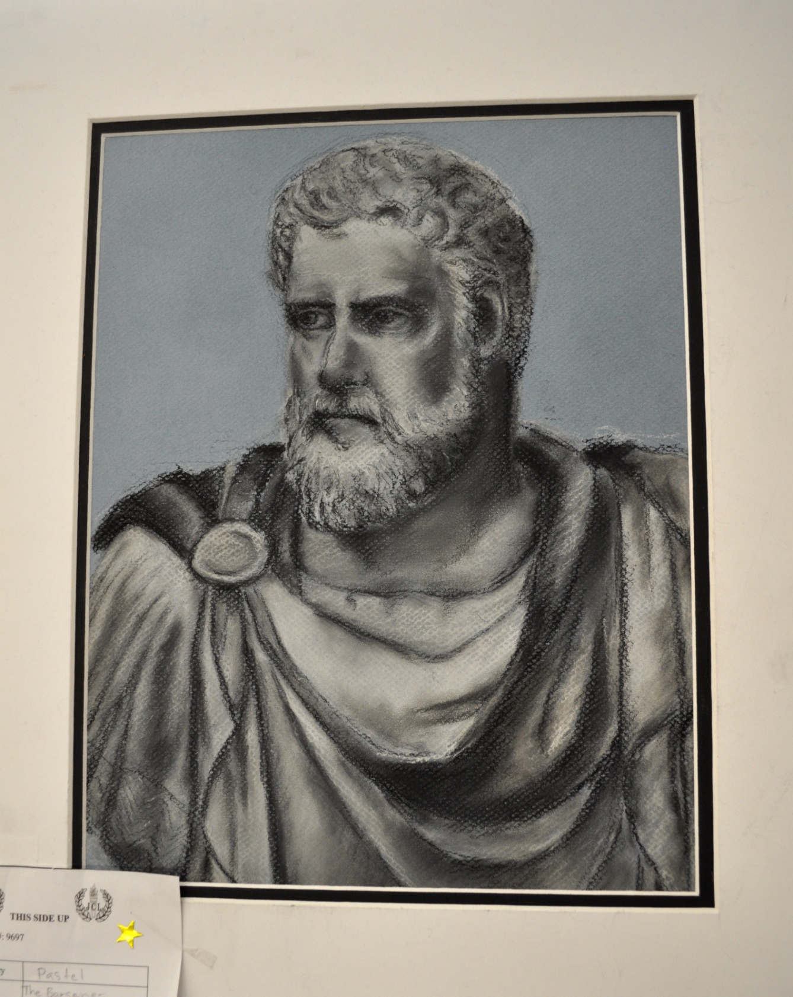

Slide 7
Best in Show:
Jewelry

Slide 8
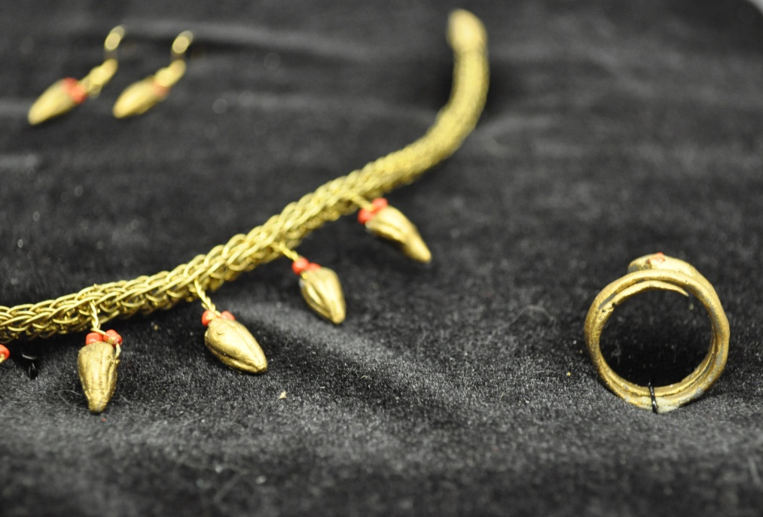
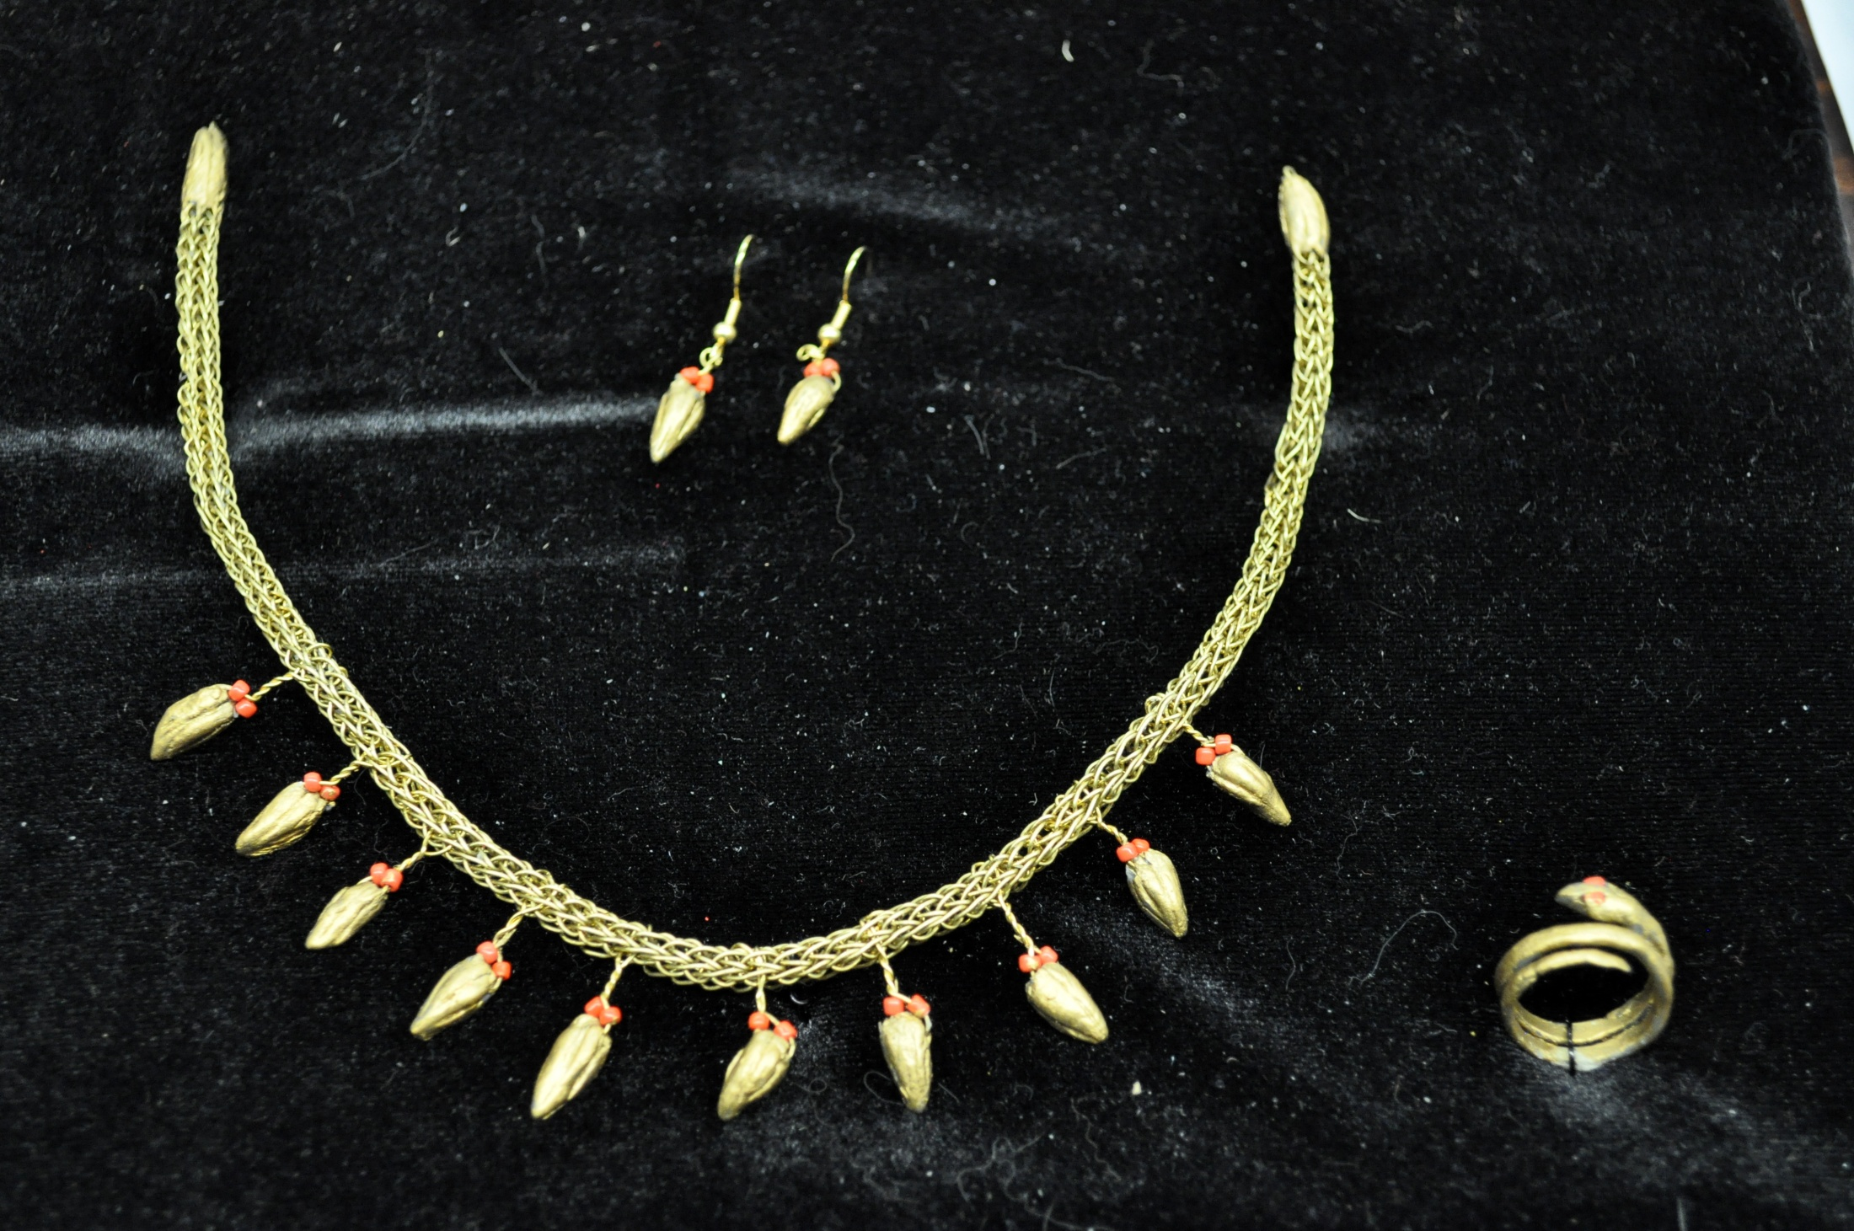

Slide 9
Best in Show:
Sculpture

Slide 10
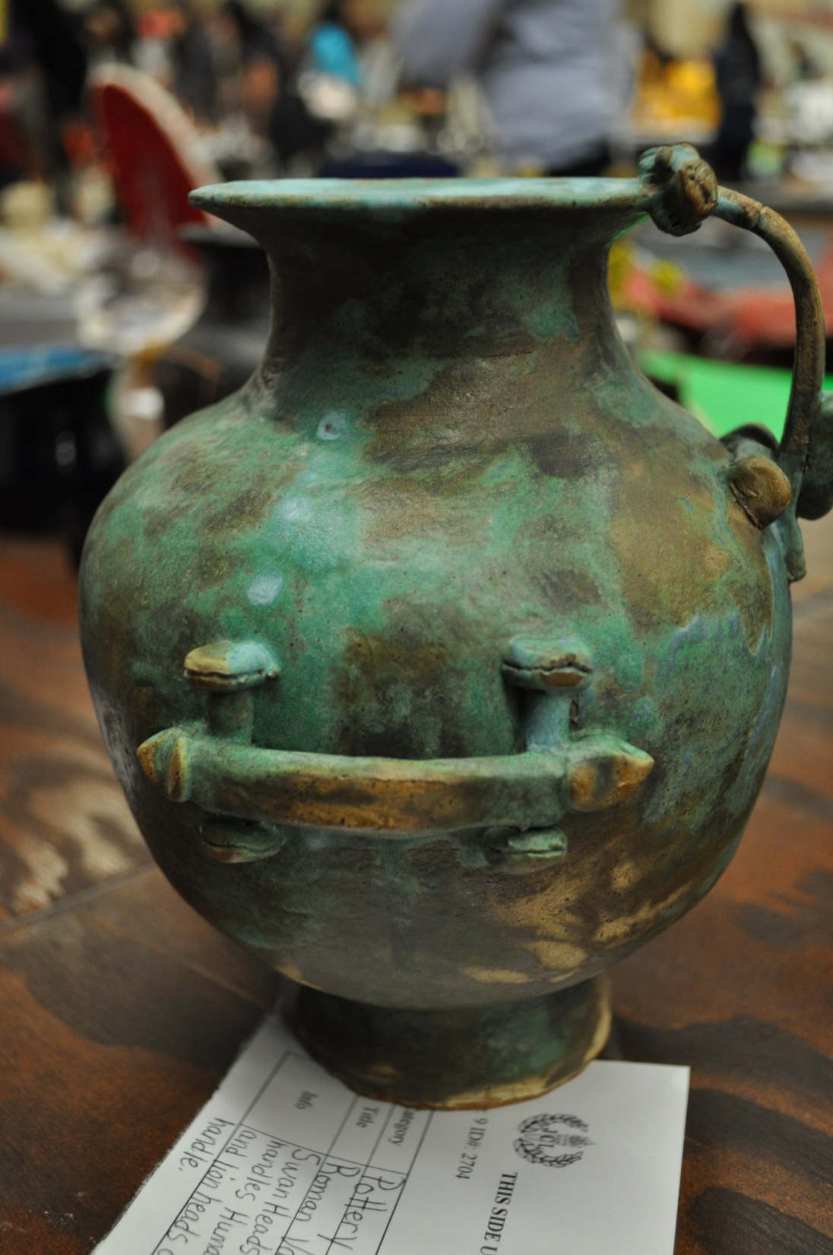
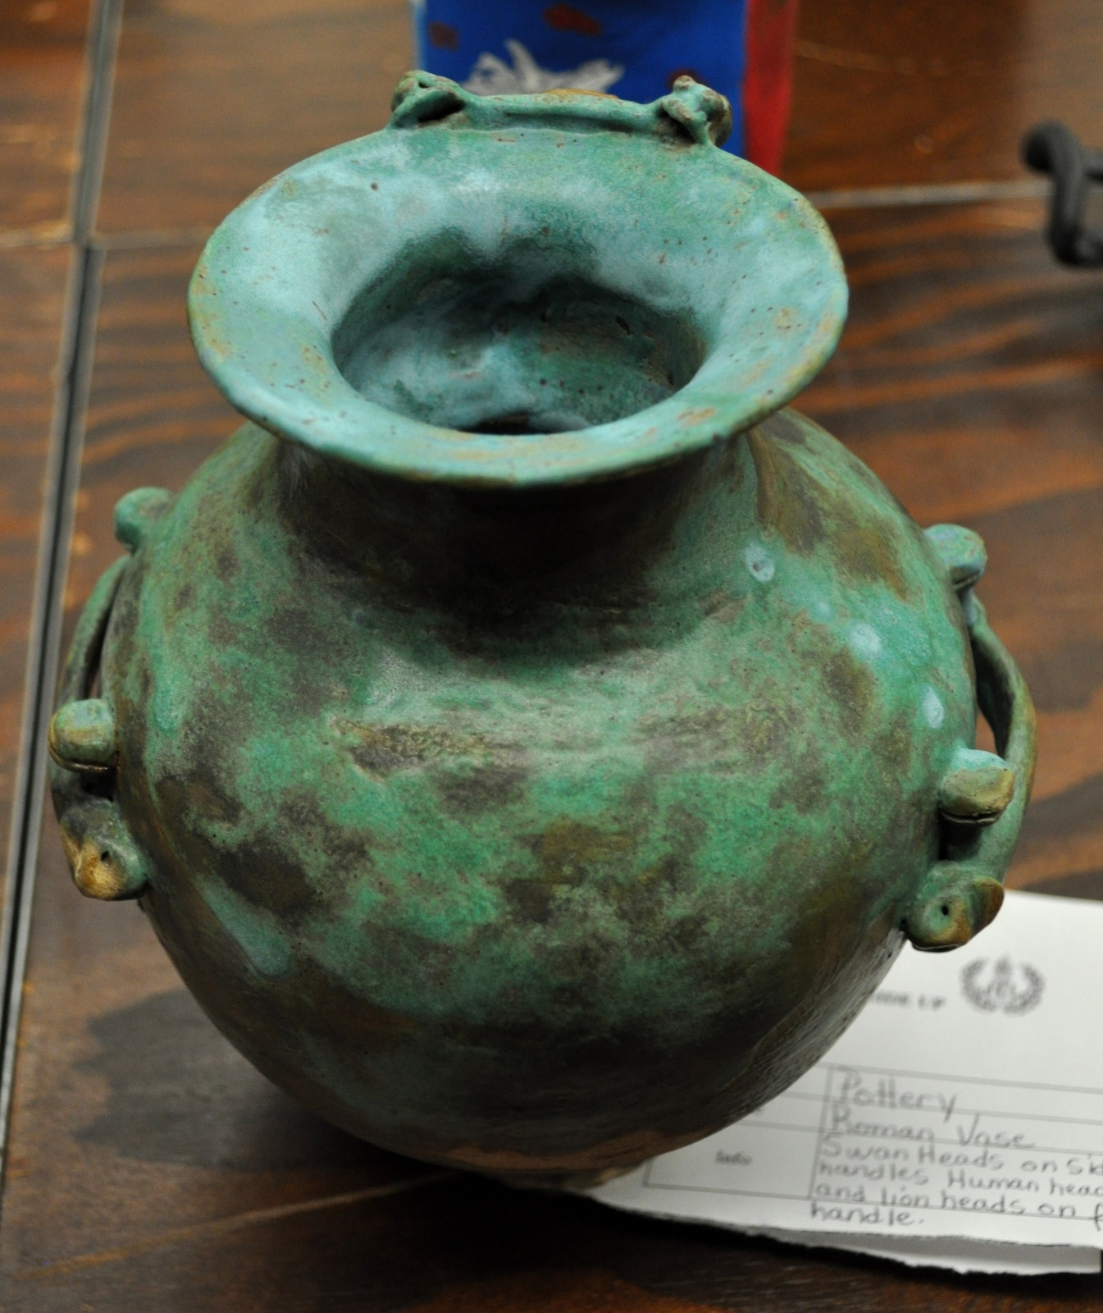

Slide 11
Best in Show:
Large Models

Slide 12
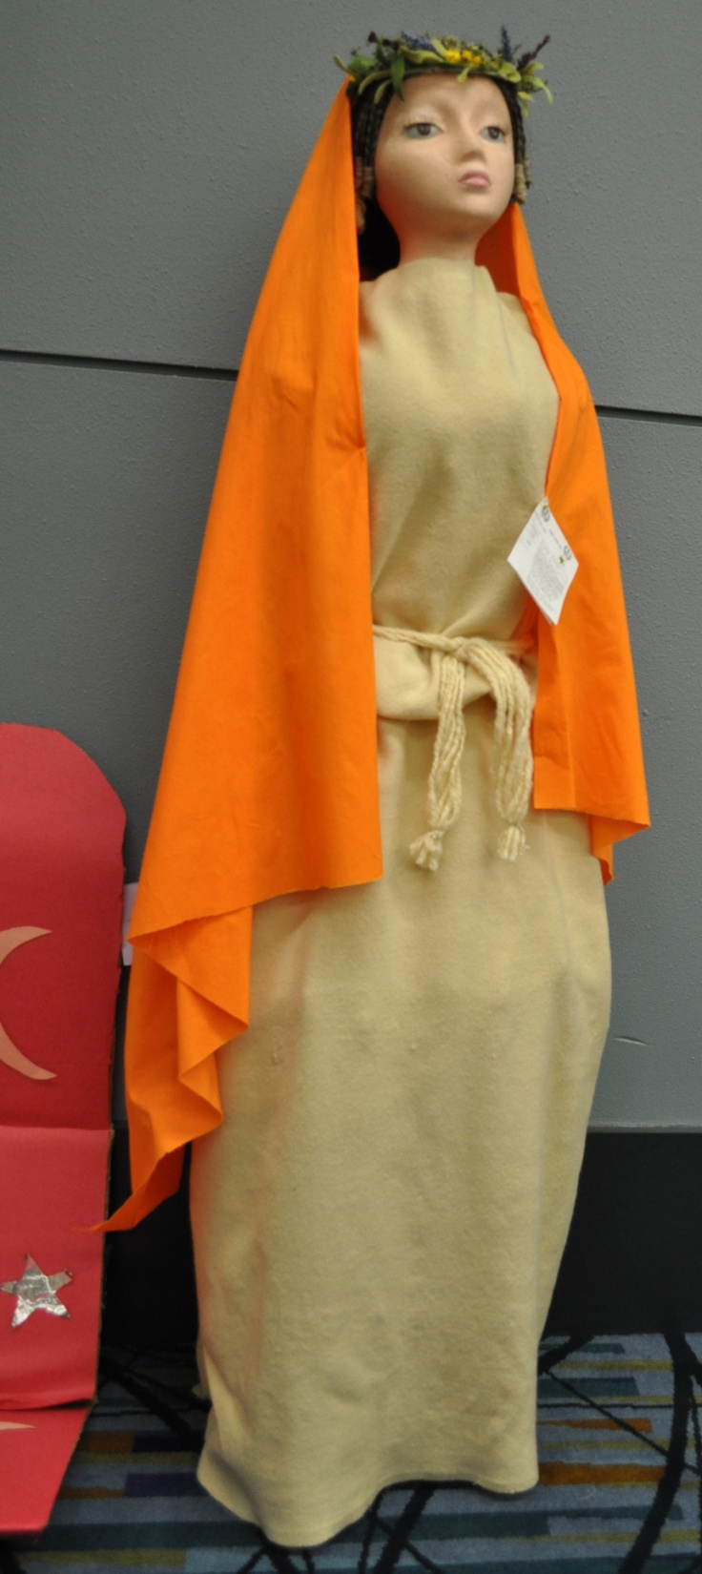
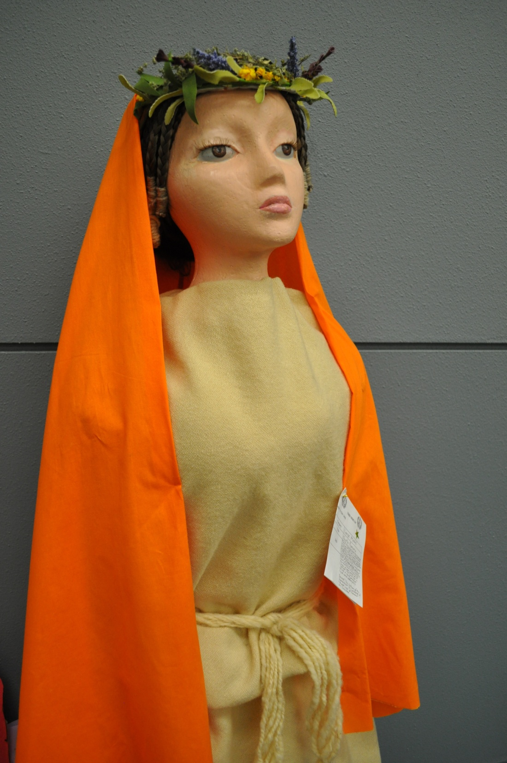

Slide 13
Best in Show: dolls/Textiles

Slide 14
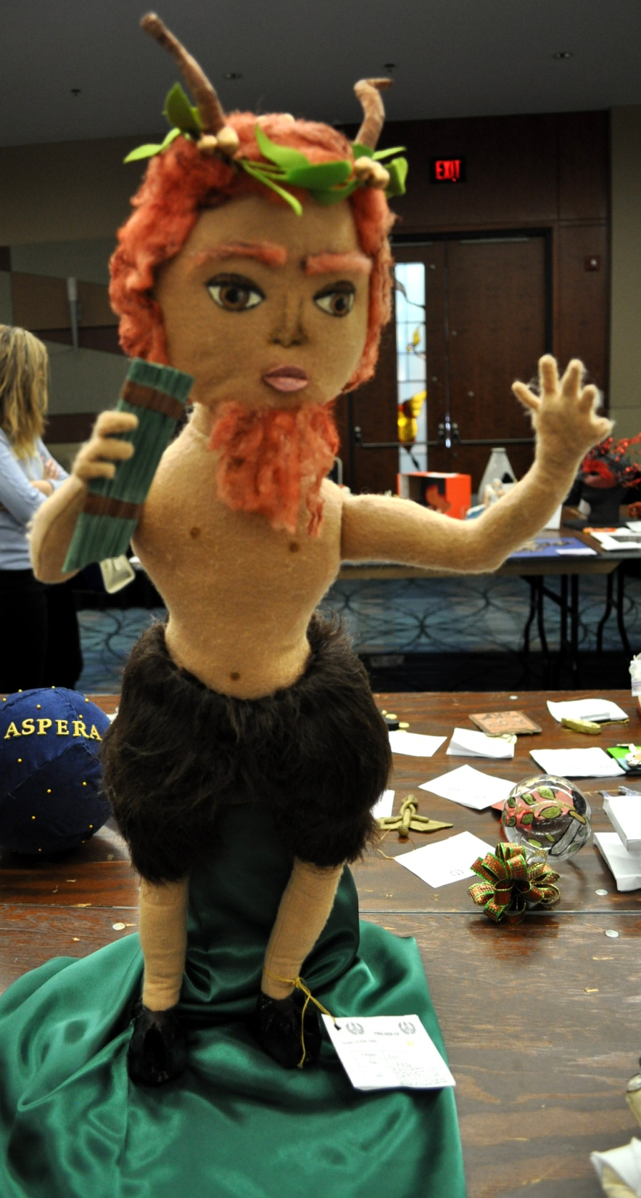
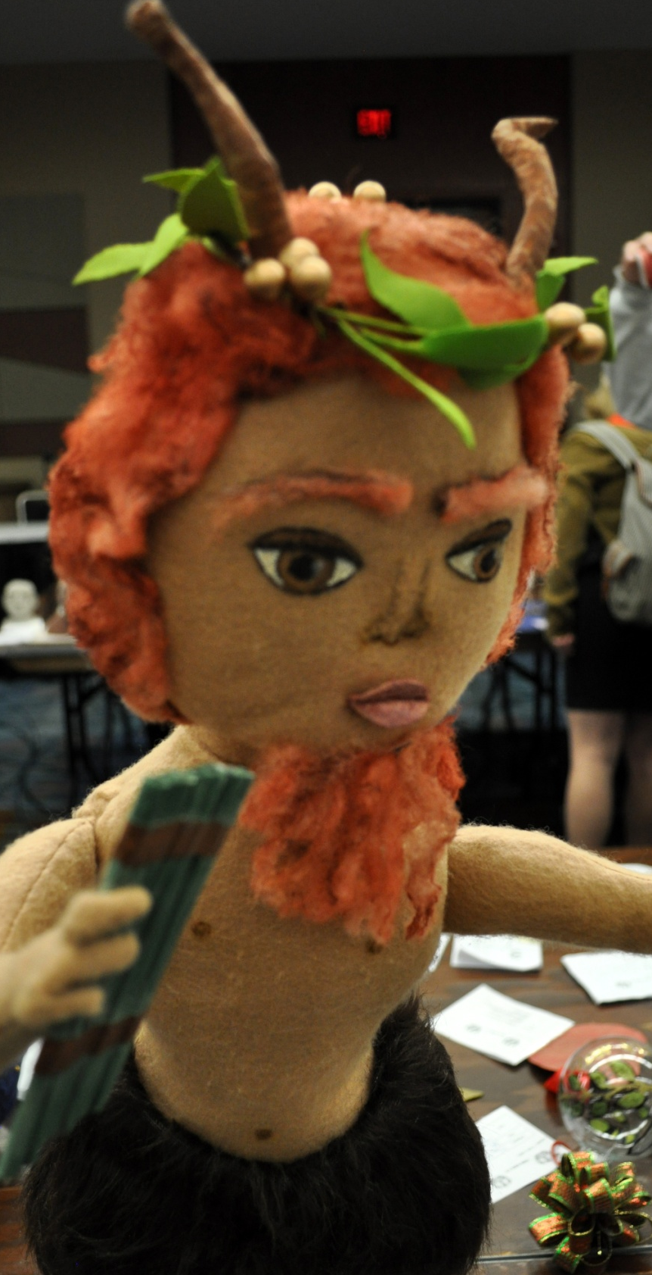

Slide 15
Best in Show:
Mosaics

Slide 16
